Slide 1

I Continuously improve your website by using customer feedback and web analytics
Insert IRS | Office of Online Services
Ins er Digital.gov event - January 25, 2023
An IRS case study
1

Slide 2
Did you know…

Slide 3
That there’s an application on IRS.gov that helps eligible people with filing their taxes for free?

Slide 4
And that we update that application to meet people’s needs every year based on customer feedback and web analytics?

Slide 5
Key takeaways
IRS Free File Program overview
User experience process used to update the application
Analytics process used to make ongoing updates to the application
Tips and tricks you can use on your next project

Slide 6
There’s an IRS Free File Program you may have heard of before

Slide 7
IRS Free File Program’s overview
The IRS Free File Program lets people prepare and file their federal income tax return online using guided tax preparation at an IRS partner site or using the Free File Fillable Forms on IRS.gov. It's safe, easy and at no cost to the public.
For more information, visit www.irs.gov/freefile

Slide 8
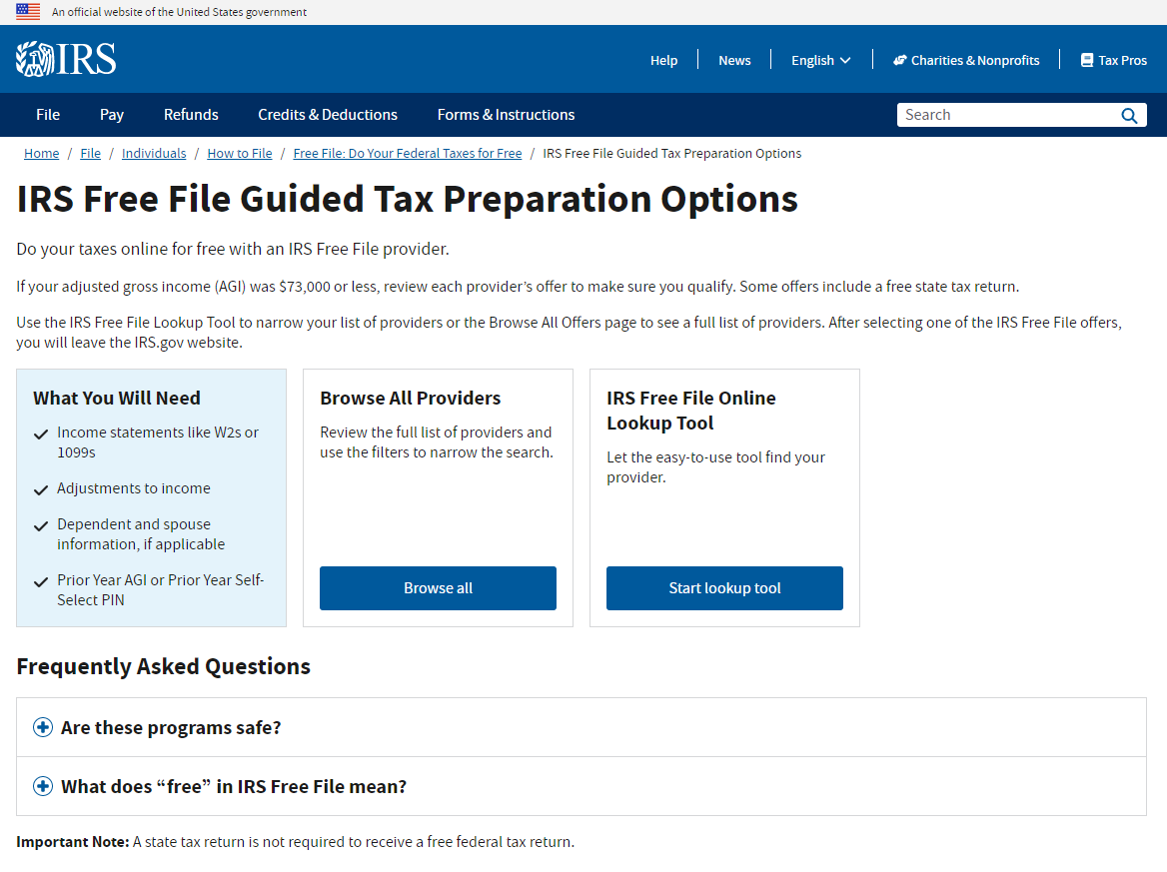
Screenshot of IRS Free File application’s homepage
¹
²
³
⁴

Slide 9
It’s all about the iterative process

Slide 10
Conceptualization process
^{Foundation}
^{Exploration}
^{Execution}
^{Measurement}
Identify Opportunities
Design the Right Products
Build the Products Right
Learn how Customers Use the Products
Who are our customers?
What do they need to succeed?
What solutions will better meet people’s needs?
How do these solutions align with business goals?
How should the IRS design and deliver a complete experience?
What enhancements could the IRS make to improve the user experience?

Slide 11
Iterative design approach
Elaboration
User Test
Refine
User Test
Build
Refine
User Test
Identify a need
Elaborate and brainstorm
Test the application with real users
Have a “refine” approach
Test again
Repeat as necessary
Update the application with continuous analytics and feedback

Slide 12
Guiding principles
Principles of a usable interface include:
Satisfaction
Efficiency
Error Prevention
Memorability
Ease of Learning
Effectiveness

Slide 13
And it’s also about collecting and analyzing data properly

Slide 14
Data analysis process
Analyze data with working group
Meet on a monthly basis
Share information with management
Coordinate with development team
Deploy changes
Add proposed updates to backlog

Slide 15
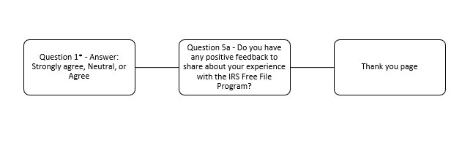
Customer survey updates
We recently updated the questions people can answer when they get the in-app survey.
Positive experience user flow

Slide 16
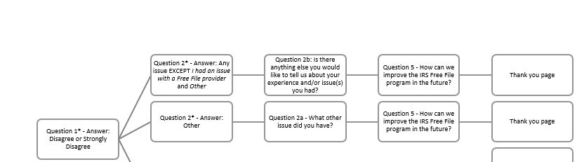
Customer survey user flow updates
Negative experience user flow: Part I

Slide 17
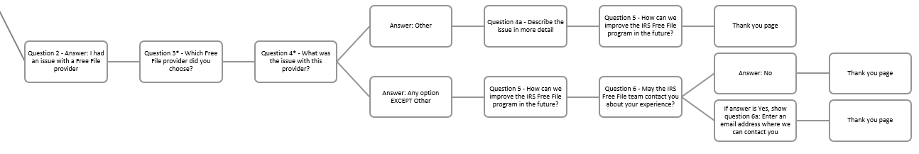
Negative experience user flow: Part II

Slide 18
Consistent analytics reports
Sessions to click out to a Free File provider
Mobile sessions vs. Non-mobile sessions
Year-Over-Year Free File provider comparison
Survey ratings (1 to 5 stars)
User quotes

Slide 19
People’s privacy
All collected data is aggregated and de-identified
Research findings and analytics details are only shared with the IRS Free File working group
All privacy approvals are in place before engaging with IRS Free File customers:
IRS Privacy and Civil Liberties Assessment approval (IRS PCLIA)
Office of Management and Budget Paperwork Reduction Act approval (OMB PRA)
Participation in the in-app survey and user testing sessions is completely voluntary and people can exit the survey/session at any time with no risk of penalty

Slide 20
Data drives actions

Slide 21
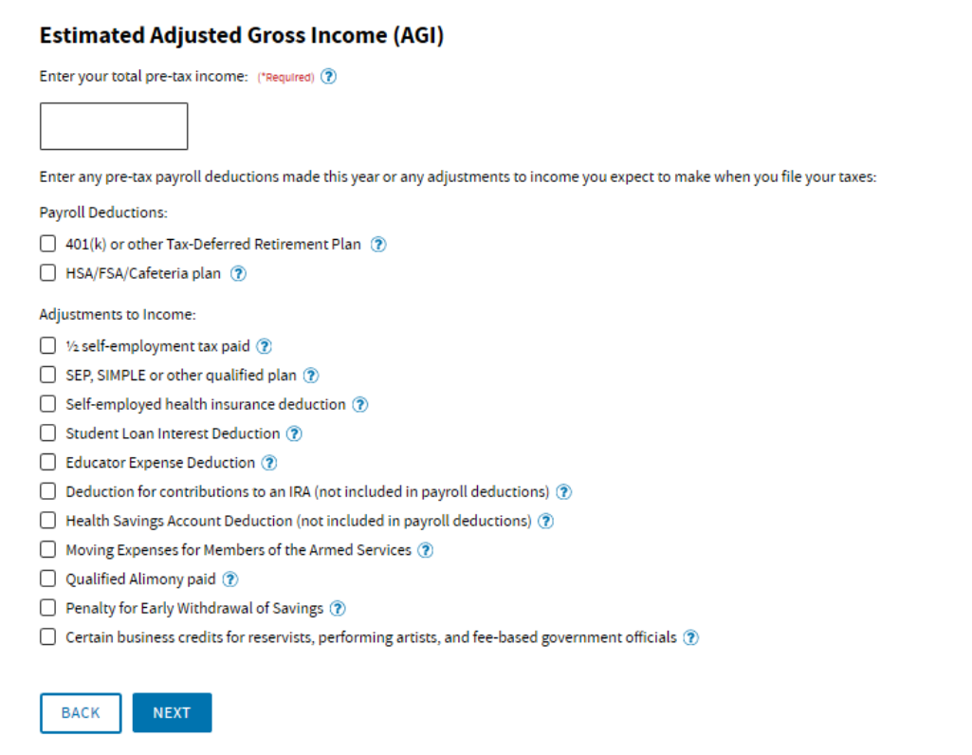
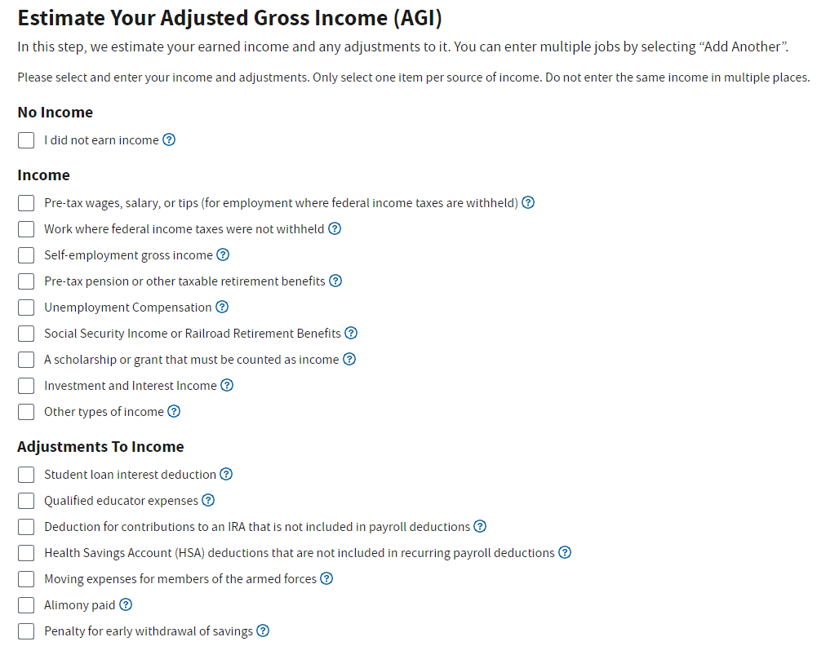
Non-filers needed to use Free File application in 2021
Before analyzing data
After analyzing data

Slide 22

Screenshot of updated AGI step with No Income option

Slide 23
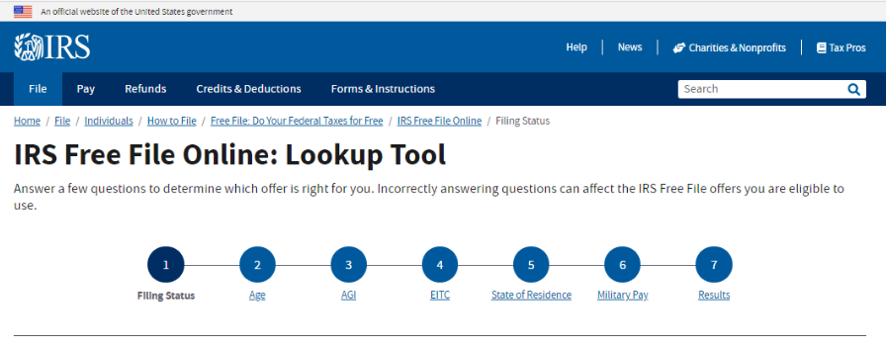
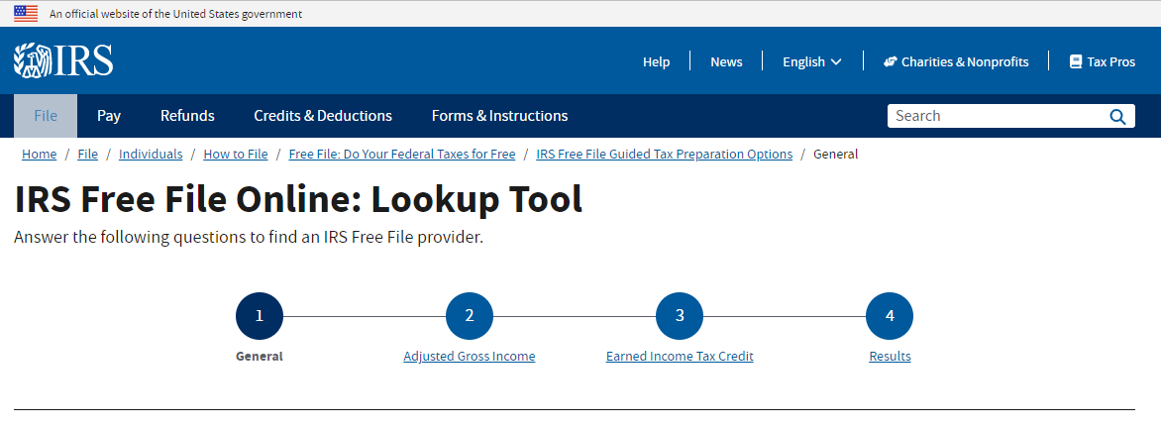
People wanted less steps in the Free File Lookup Tool
Before analyzing data
After analyzing data

Slide 24
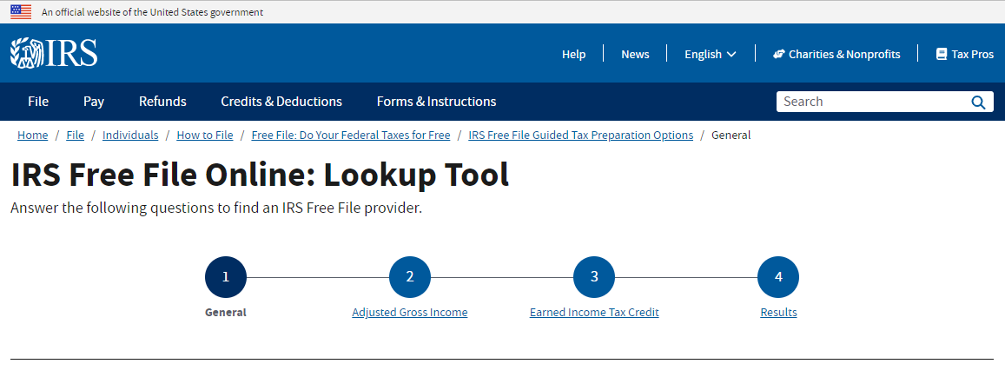
Screenshot of updated IRS Free File Lookup Tool steps

Slide 25
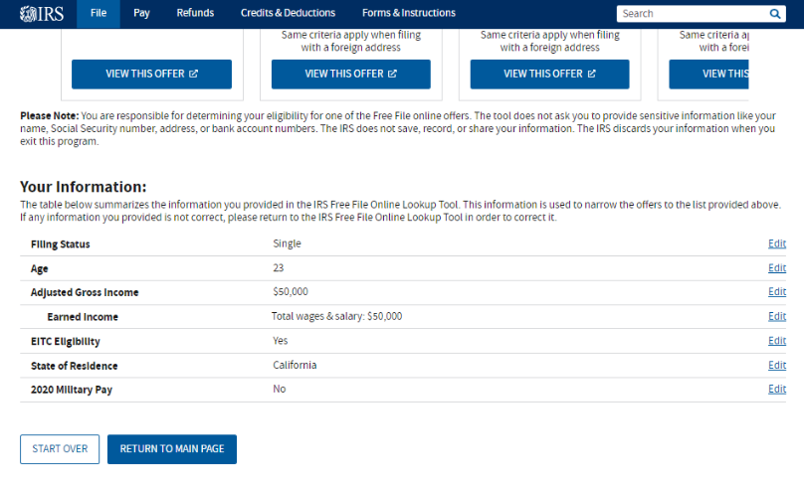
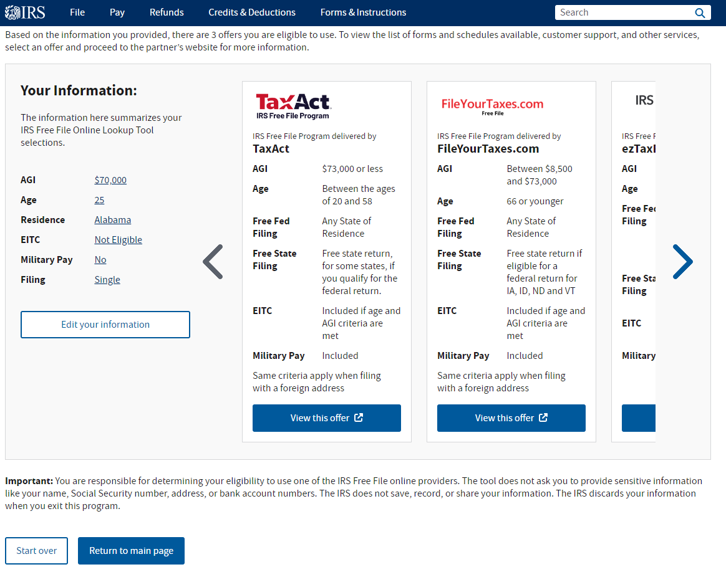
People wanted to see their answers more prominently
Before analyzing data
After analyzing data

Slide 26
Screenshot of updated Results page

Slide 27
This experience taught us so much

Slide 28
Recipe for success
Include business owner
Prioritize communication and have meeting agendas
Understand your stakeholders
Include a feedback button

Slide 29
More team members to consider
Section 508 and Web Content Accessibility Guidelines experts
Development team and web analytics experts

Slide 30
Important rules to follow
Test, test, test and test
Use quotes from user testing sessions and survey responses
Don’t be afraid to say that something you worked on in the past needs to be improved or updated after you analyze your data

Slide 31
Thank you for joining us today! Sam Chapman Samuel.L.Chapman@irs.gov Kira Prin Kira.Prin@irs.gov

